Slide 1
Machine Learning
Dr. Monali Mavani

Slide 2

Machine Learning
Disclaimer and Acknowledgement
These content of modules & context under topics are planned by the course owner Dr. Sugata, with grateful acknowledgement to many others who made their course materials freely available online
We here by acknowledge all the contributors for their material and inputs.
We have provided source information wherever necessary
Students are requested to refer to the textbook w.r.t detailed content of the presentation deck shared over canvas
We have reduced the slides from canvas and modified the content flow to suit the requirements of the course and for ease of class presentation
Slide Source / Preparation / Review:
From BITS Pilani WILP: Prof.Sugata, Prof.Chetana, Prof.Rajavadhana, Prof.Monali, Prof.Sangeetha, Prof.Swarna, Prof.Pankaj
External: CS109 and CS229 Stanford lecture notes, Dr.Andrew NG and many others who made their course materials freely available online

Slide 3
Contents
Evaluation metrics - classification

Slide 4
Confusion matrix
Confusion matrix: 2 by 2 table
What happened vs What should have happened
 | ML system says
Ground truth |  | Class=Yes | Class=No
 | Class=Yes | a (TP) | b (FN)
 | Class=No | c (FP) | d (TN)
Mistakes: FN and FP
Question: Which mistakes are worse than other mistakes?

Slide 5


Evaluation metric for classification problems
 | PREDICTED CLASS
ACTUAL CLASS |  | Class=Yes | Class=No
 | Class=Yes | a (TP) | b (FN)
 | Class=No | c (FP) | d (TN)
Accuracy is the fraction of predictions
our model got right. Formally, accuracy
has the following definition:
For binary classification, accuracy can also be calculated in terms of positives and negatives as follows:

Slide 6
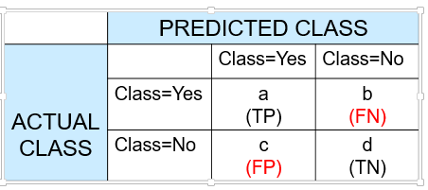
Problem with Accuracy
Consider a 2-class problem
Number of Class NO examples = 990
Number of Class YES examples = 10
If a model predicts everything to be class NO, accuracy is 990/1000 = 99 %
This is misleading because this trivial model does not detect any class YES example
Detecting the rare class is usually more interesting (e.g., frauds, intrusions, defects, etc)
 | PREDICTED CLASS
ACTUAL CLASS |  | Class=Yes | Class=No
 | Class=Yes | 0 | 10
 | Class=No | 0 | 990

Slide 7
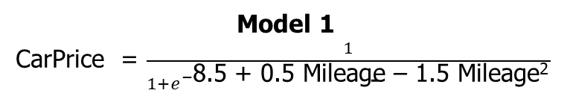
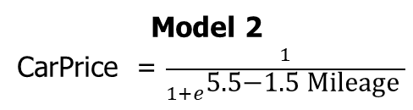
Which model is better?
Mileage (in kmpl) | Car Price (in cr)
9.8 | High
9.12 | Low
9.5 | High
10 …. | Low …
Unseen Data
Mileage (in kmpl) | Car Price (in cr)
7.5 | High
10 | Low
…. | …..
 | PREDICTED
ACTUAL |  | Class=Y | Class=N
 | Class=Y | 0 | 10
 | Class=N | 0 | 990
Accuracy: 99%
 | PREDICTED
ACTUAL |  | Class=Y | Class=N
 | Class=Y | 10 | 0
 | Class=N | 500 | 490
Accuracy: 50%

Slide 8


Alternative Measures
Two widely used metrics used where successful detection of one of the classes is considered more significant than detection of the other classes
What proportion of positive identifications was actually correct?
It is the accuracy of the positive predictions
A model that produces no false positives has a precision of 1.0.
A system with high precision might leave some good items out but, what it returns of high quality e.g. book recommender system, safe video recommender system for kids
# positives correct / # labelled positive
Also called sensitivity or true positive rate
What proportion of actual positives was identified correctly?
This is the ratio of positive instances that are correctly detected by the classifier
A model that produces no false negatives has a recall of 1.0
A system with high recall might give you lot of bad items but, it also returns most of the good items e.g robbing the shop, candidate hiring, detect shoplifters on surveillance images
# positives correct / # actually positive

Slide 9
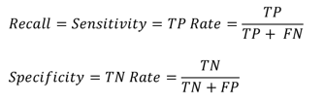
Sensitivity and Specificity
Sensitivity: the ability of a test to correctly identify patients with a disease.
Specificity: the ability of a test to correctly identify people without the disease.
 | ML system says
Ground truth |  | Class=Yes | Class=No
 | Class=Yes | a (TP) | b (FN)
 | Class=No | c (FP) | d (TN)

Slide 10

Precision and Recall
Precision/recall tradeoff : increasing precision reduces recall, and vice versa.
F₁ score :
Suitable for class imbalance cases
high F₁ score if both recall and precision are High
F-score of 1.0, indicating perfect precision and recall
 | ML system says
Ground truth |  | Class=Yes | Class=No
 | Class=Yes | a (TP) | b (FN)
 | Class=No | c (FP) | d (TN)

Slide 11
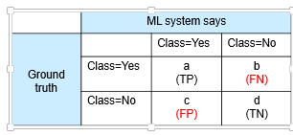
Which Classifier is better? – Cancer prediction Low FN rate
 | PREDICTED CLASS
ACTUAL CLASS |  | Class=Yes | Class=No
 | Class=Yes | 10 | 0
 | Class=No | 10 | 980
FN to be minimized – use RECALL
Want to make sure all people with cancer will be caught
FP to be minimized – use Precision
Want to say confidently that a person has cancer
 | PREDICTED CLASS
ACTUAL CLASS |  | Class=Yes | Class=No
 | Class=Yes | 1 | 9
 | Class=No | 0 | 990

Slide 12
Which Classifier is better? – SPAM email prediction Low FP rate
 | PREDICTED CLASS
ACTUAL CLASS |  | Class=Yes | Class=No
 | Class=Yes | 10 | 0
 | Class=No | 10 | 980
FN to be minimized – use RECALL
Want to make sure all SPAM emails are filtered
FP to be minimized – use PRECISION
Want to confidently say email is SPAM
 | PREDICTED CLASS
ACTUAL CLASS |  | Class=Yes | Class=No
 | Class=Yes | 1 | 9
 | Class=No | 0 | 990

Slide 13
Which Classifier is better? Low Skew
F1 score favors classifiers that have similar precision and recall i.e. low false positives and low false negatives
T1 | PREDICTED CLASS
ACTUAL CLASS |  | Class=Yes | Class=No
 | Class=Yes | 50 | 50
 | Class=No | 1 | 99
F1=0.66
F1=0.94
T2 | PREDICTED CLASS
ACTUAL CLASS |  | Class=Yes | Class=No
 | Class=Yes | 99 | 1
 | Class=No | 10 | 90
T3 | PREDICTED CLASS
ACTUAL CLASS |  | Class=Yes | Class=No
 | Class=Yes | 99 | 1
 | Class=No | 1 | 99
F1=0.99

Slide 14
Which Classifier is better? Medium Skew case
T1 | PREDICTED CLASS
ACTUAL CLASS |  | Class=Yes | Class=No
 | Class=Yes | 50 | 50
 | Class=No | 10 | 990
F1=0.62
T2 | PREDICTED CLASS
ACTUAL CLASS |  | Class=Yes | Class=No
 | Class=Yes | 99 | 1
 | Class=No | 100 | 900
F1=0.66
T3 | PREDICTED CLASS
ACTUAL CLASS |  | Class=Yes | Class=No
 | Class=Yes | 99 | 1
 | Class=No | 10 | 990
F1=0.94

Slide 15
Which Classifier is better? High Skew case
T1 | PREDICTED CLASS
ACTUAL CLASS |  | Class=Yes | Class=No
 | Class=Yes | 50 | 50
 | Class=No | 100 | 9900
F1=0.375
T2 | PREDICTED CLASS
ACTUAL CLASS |  | Class=Yes | Class=No
 | Class=Yes | 99 | 1
 | Class=No | 1000 | 9000
F1=0.165
T3 | PREDICTED CLASS
ACTUAL CLASS |  | Class=Yes | Class=No
 | Class=Yes | 99 | 1
 | Class=No | 100 | 9900
F1=0.66

Slide 16
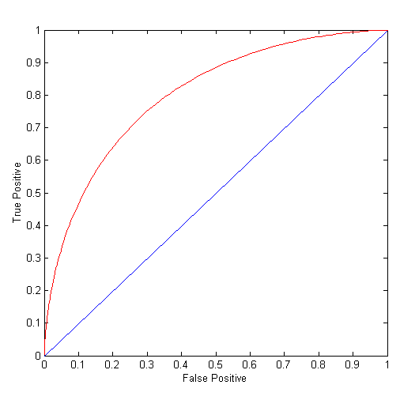
ROC (Receiver Operating Characteristic)
A graphical approach for displaying trade-off between detection rate and false alarm rate
Developed in 1950s for signal detection theory to analyze noisy signals
ROC curve plots TPR against FPR
TPR: fraction of positive examples predicted correctly by the mode
FPR: fraction of negative examples predicted as a positive class

Slide 17


ROC Curve
Critical points along an ROC curve
(TPR,FPR)
(0,0): Model predicts every instance to be a negative class
(1,1): Model predicts every instance to be a positive class
(1,0): ideal
Diagonal line:
Random guessing
Below diagonal line:
prediction is opposite of the true class\
Higher the recall (TPR), the more false positives
Notes:
Increasing recall (high true positive rate) for the tumor classification model means capturing as many actual tumorous cases as possible. However, this may lead to low precision (high false positive rate) as the model will classify many non-tumorous cases as tumorous.

Slide 18
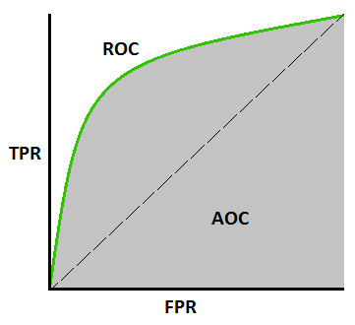
Comparing classifiers using AUC
Area Under Curve (AUC)
Integrate Area under the curve
Perfect score is 1
Higher scores allow for generally better tradeoffs
AUC of 0.5 indicates model is essentially randomly guessing
AUC of < 0.5 indicates you’re doing something wrong…
Scikit-Learn provides a function to compute the ROC-AUC:
from sklearn.metrics import roc_auc_score
For model comparison, AUC of ROC should be larger for the model to be superior or better performing

Slide 19
How to Construct an ROC curve
Use a classifier that produces a continuous-valued score for each instance
The more likely it is for the instance to be in the + class, the higher the score
Sort the instances in decreasing order according to the score
Apply a threshold at each unique value of the score
Count the number of TP, FP, TN, FN at each threshold
TPR = TP/(TP+FN)
FPR = FP/(FP + TN)
Instance | Score | True Class
1 | 0.95 | +
2 | 0.93 | +
3 | 0.87 | -
4 | 0.85 | -
5 | 0.85 | -
6 | 0.85 | +
7 | 0.76 | -
8 | 0.53 | +
9 | 0.43 | -
10 | 0.25 | +

Slide 20
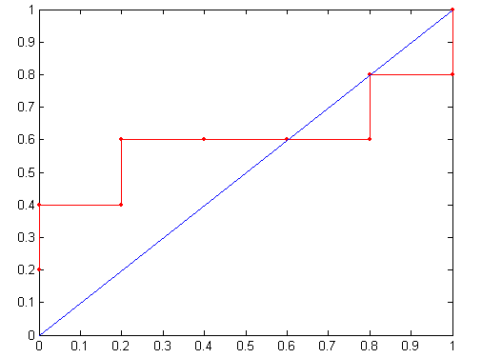
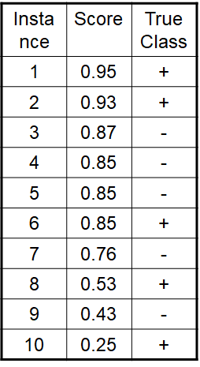
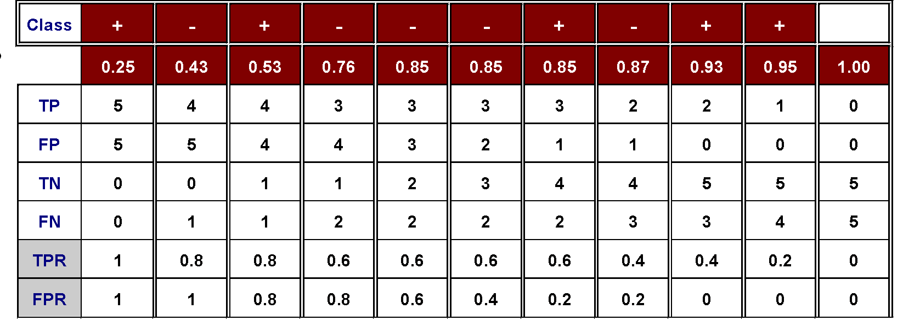
How to construct an ROC curve
Threshold >=
ROC Curve:

Slide 21
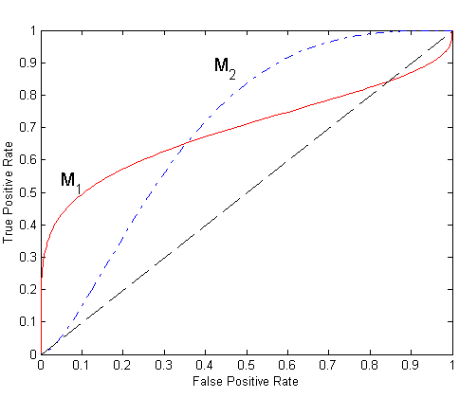
Using ROC for Model Comparison
No model consistently outperforms the other
M1 is better than M2 when FPR is less than 0.36
M2 is superior when FPR is greater than 0.36

Slide 22
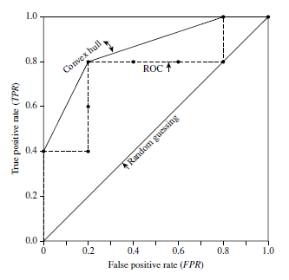
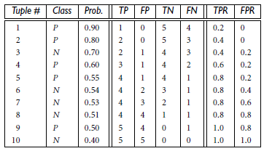
Example
The table below shows the probability value (column 3) returned by a probabilistic classifier for each of the 10 tuples in a test set, sorted by decreasing probability order. The corresponding ROC is given on right hand side.

Slide 23
Solution to Class Imbalance
Generate Synthetic Samples
New samples based on the distances between the point and its nearest neighbors E.g. Synthetic Minority Oversampling Technique, or SMOTE class in sklearn
Change the performance metric : Use Recall, Precision or ROC curves instead of accuracy
Try different algorithms : Some algorithms as Support Vector Machines and Tree-Based algorithms may work better with imbalanced classes.

Slide 24
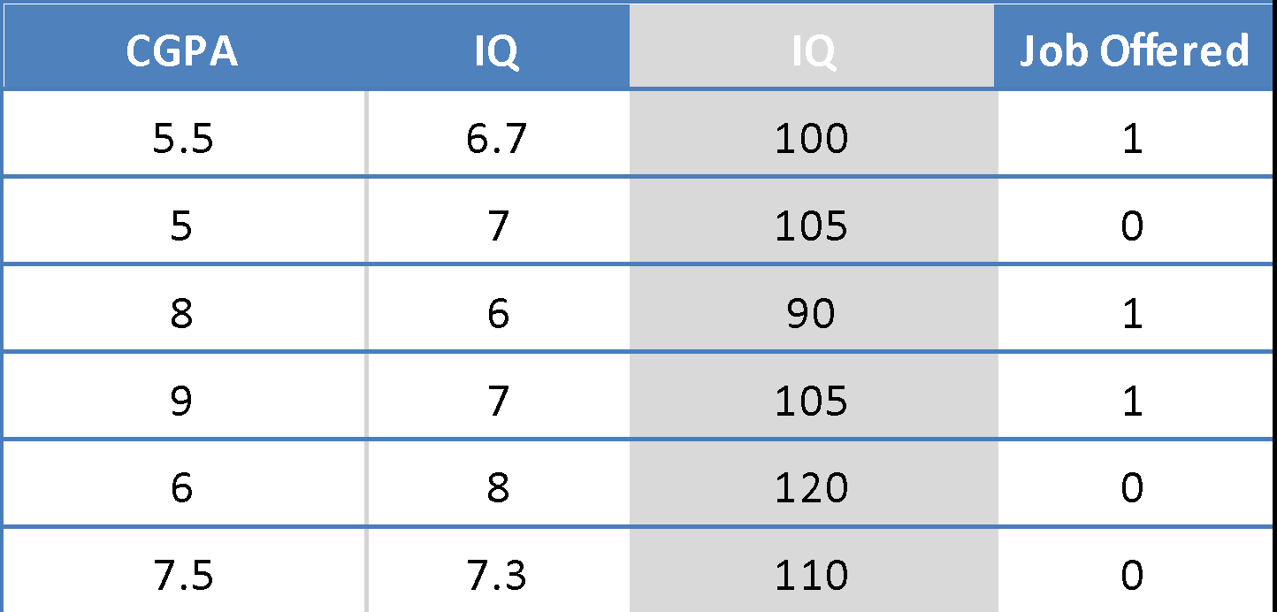
Logistic Regression –Additional Practice Exercises
Hyper parameters:
Learning Rate = 0.8
Initial Weights = (-0.1, 0.2,-0.5)
Regularization Constant = 10
For this similar problem discussed in class note that the hyper parameters are different
Formulate the gradient descent update equations for this problem
Repeat the GD for two iterations
Find the Loss at every iterations and interpret your observation
Using the results of second iteration answer below questions:
Interpret the influence of the CGPA in the response variable
Predict if a new candidates with IQ=5 and CGPA = 9 will be offered job or not?
Repeat the steps 2 to 4 by using stochastic gradient descent instead of batch gradient descent for 4 iterations. (Take any random sample from among 6 instances for these 4 iterations)

Slide 25
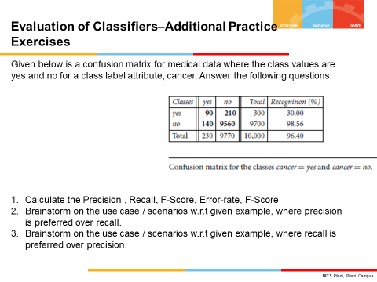

Slide 26
References
Ch 1,3 – Hands-on Machine Learning with Scikit-Learn, Keras, and TensorFlow by Aurélien Géron
Ch 5 - Introduction to Data Mining by Pang-Ning Tan Michael Steinbach Vipin Kumar
https://developers.google.com/machine-learning/crash-course/classification/roc-and-auc

